Slide 1

Visual Vibrometry: Estimating Material Properties from Small Motions in Video
${\text{Abe} \text{Davis}}^{1}$, ${Katherine L. Bouman}^{1}$, ${Ju\text{stin} \text{G}\text{. }\text{Chen}}^{1}$, ${\text{Michael} Rubinstein}^{2},{\text{Fredo} \text{Durand}}^{1}$, ${\text{William} \text{T}\text{. }\text{Freeman}}^{1}$
$$1_{\text{Computer} \text{Science} \text{and} \text{Artificial} \text{Intelligence} \text{Laboratory}\text{ (}\text{CSAIL}\text{), }\text{MIT}\text{, }\text{USA} }$$
$$2_{\text{Google} \text{Research}}$$
Presented by Deblina Bhattacharjee
Intelligent Media Research Centre, Postech- Samsung

Slide 2
Visual Vibrometry
Intelligent Media Lab @ POSTECH
Approach
Presents a technique to estimate material properties for objects with fixed or known geometry from small motions in video.
Solid objects tend to vibrate at a set of preferred frequencies.
These vibrations occur at frequencies outside the range of human visual perception.
These vibrations can be recovered from video, even for motion smaller than 1 pixel.

Slide 3

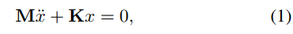
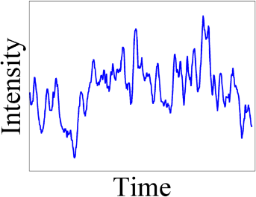
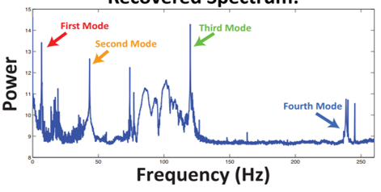
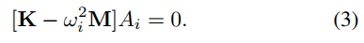
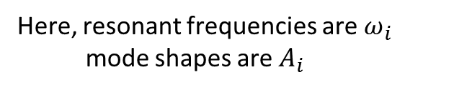
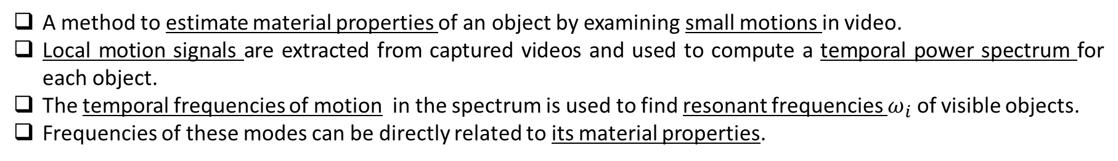
Overview
Intelligent Media Lab @ POSTECH
A method to estimate material properties of an object by examining small motions in video.
Local motion signals are extracted from captured videos and used to compute a temporal power spectrum for each object.
The temporal frequencies of motion in the spectrum is used to find resonant frequencies $ω_{i}$ of visible objects.
Frequencies of these modes can be directly related to its material properties.
Here, resonant frequencies are $ω_{i}$
mode shapes are $A_{i}$
Video
From eigenmode analysis

Slide 4
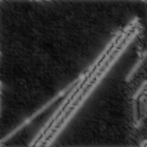
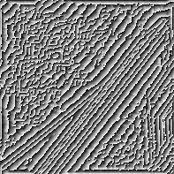


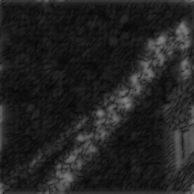
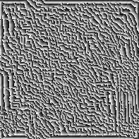


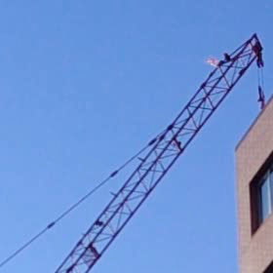


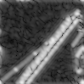



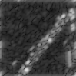

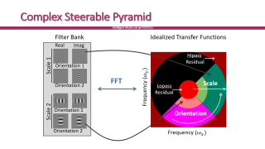
Motion Extraction
Intelligent Media Lab @ POSTECH
Using complex valued steerable pyramids of the image, the local phase variations in every spatial sub-band of the image is extracted which gives the motions in these spatial image sub-bands.
Real
Imag
Scale 1
Orientation 1
Bandpass Filters iterations
Orientation 2
Scale 2
Orientation 1
Orientation 2

Slide 5
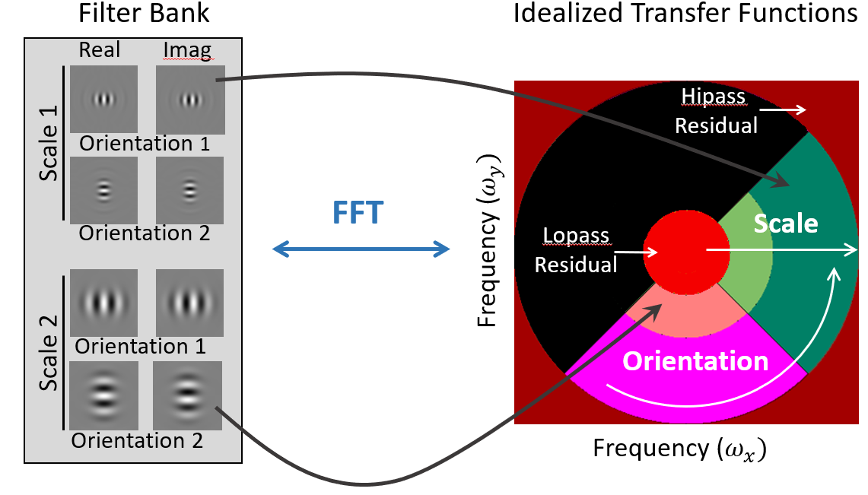
Complex Steerable Pyramid
Intelligent Media Lab @ POSTECH

Slide 6
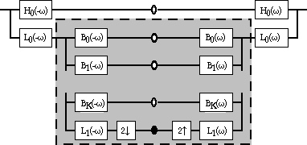
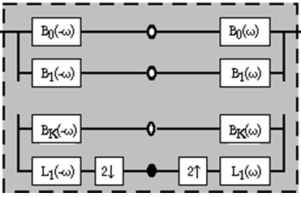
Complex Steerable Pyramid
Intelligent Media Lab @ POSTECH
High-pass filter
signal
synthesized signal
Low-pass filter
Band-pass filter
Subsampling (downsampling)
... (recursively defined)

Slide 7
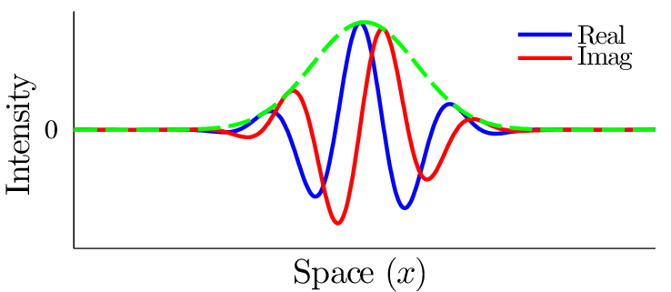
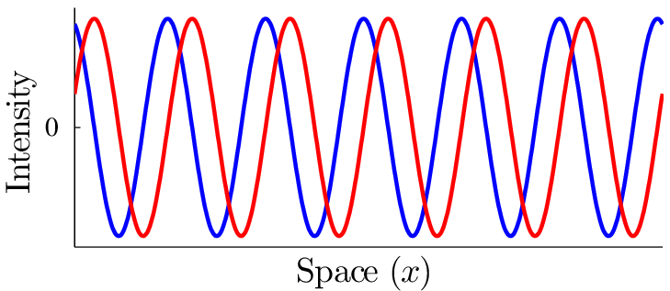
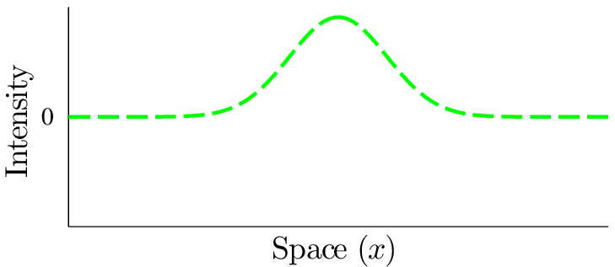

Complex Steerable Pyramid Basis Functions
Intelligent Media Lab @ POSTECH
Intensity
Space (x)
$$×$$
Intensity
Intensity
Space (x)
Space (x)
Complex Sinusoid (Global)
Window

Slide 8
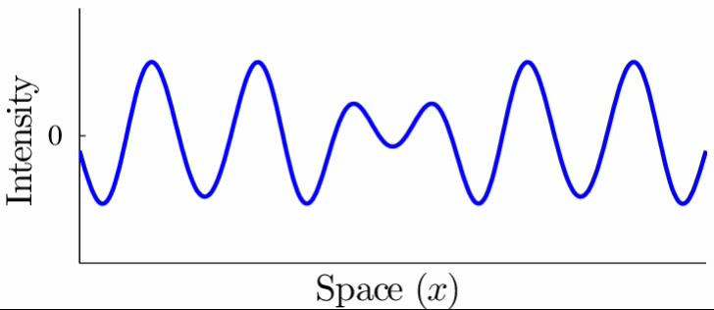
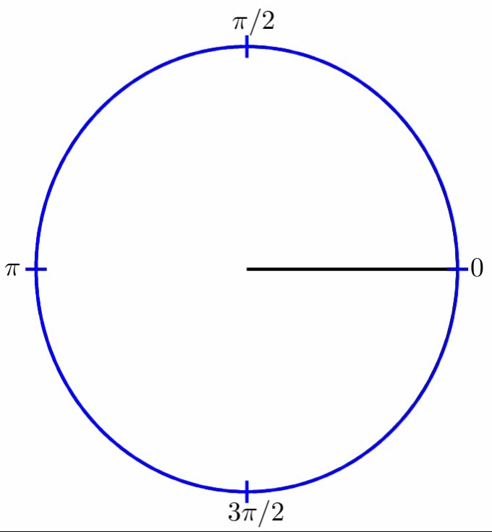
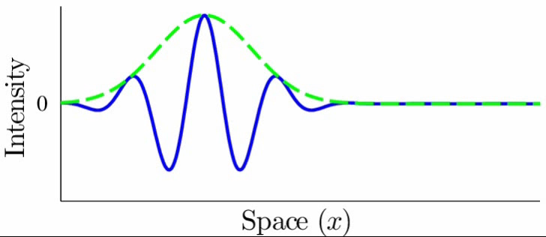
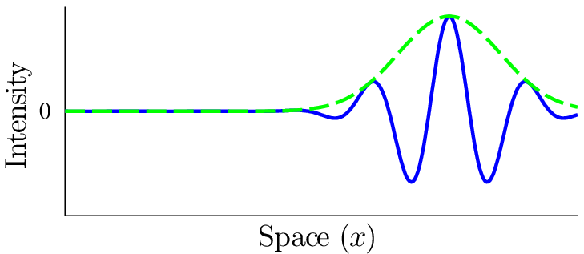

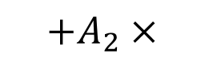
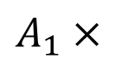
Local Amplitude
Intelligent Media Lab @ POSTECH
Local amplitude controls strength of basis function
$$=$$
$A_{1}×$
Single Sub-band of Image Profile
Local Amplitude
$${+A}_{2}×$$

Slide 9
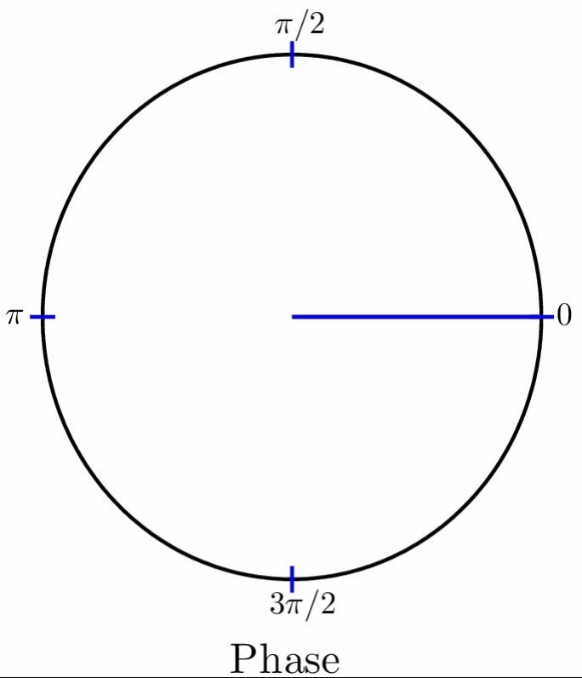




Local Phase Shifts
Intelligent Media Lab @ POSTECH
Local phase controls location of sinusoid under window, approximates local translation
$$=$$
$A_{1}×$
Local Motions
Single Sub-band of Image Profile
Local Phase
$${+A}_{2}×$$
$+…$

Slide 10
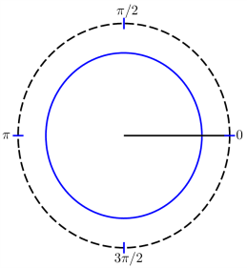
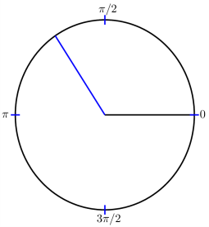
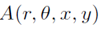
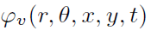


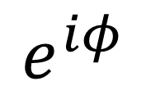
Complex Steerable Pyramid Decomposition
Intelligent Media Lab @ POSTECH
Filter Bank
Amplitude
Phase
Real
Imag
Amplitude
Phase
Scale 1
Orientation 1
$$e^{iφ}$$
$$A$$
$$×$$
Bandpass Filters iterations
Orientation 2
Scale 2
Orientation 1
Orientation 2
Sub-bands

Slide 11
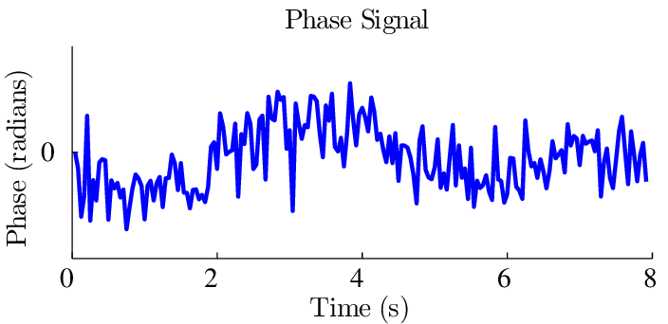
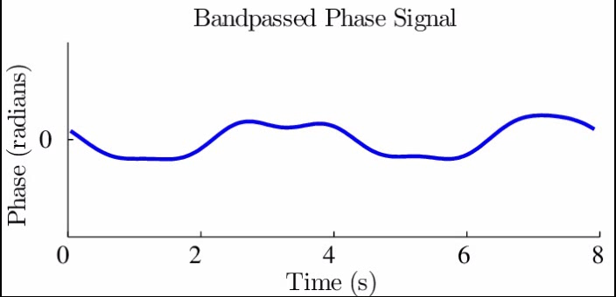
Phase Over Time
Intelligent Media Lab @ POSTECH
Filter Bank
Amplitude
Phase
Local Phase Variation calculated below gives the motion estimation.
Real
Imag
Scale 1
Orientation 1
Orientation 2
Temporal Filtering
Scale 2
Orientation 1
Orientation 2
Sub-bands

Slide 12
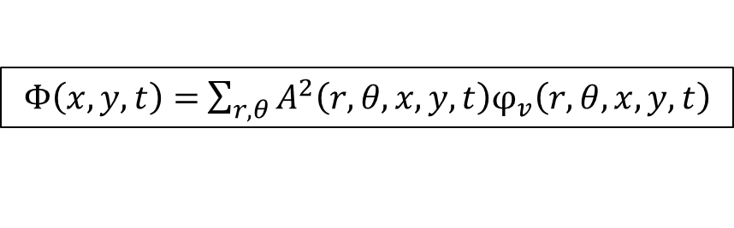
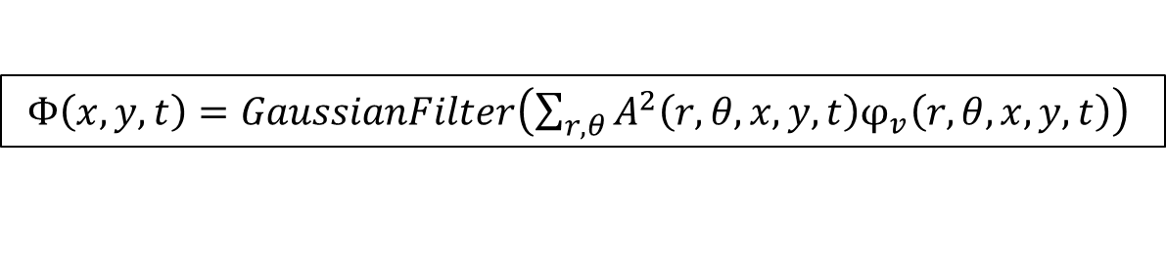
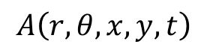
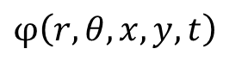
Motion Extraction
Intelligent Media Lab @ POSTECH
$$A\left(r,θ,x,y,t\right)$$
$φ\left(r,θ,x,y,t\right)$
Let: be amplitude and be the phase function of input signal.
Motion signal can be generated using phase variation of the complex steerable pyramid of image.
The local motion is computed by summing the square of amplitude in pyramid w.r.t phase difference.
$Φ\left(x,y,t\right)=$ $\sum_{r,θ}{A^{2}\left(r,θ,x,y,t\right)φ_{v}\left(r,θ,x,y,t\right)}$
Spatial Filtering the above signal for removing noise.
$Φ\left(x,y,t\right)=GaussianFilter\left(\sum_{r,θ}{A^{2}\left(r,θ,x,y,t\right)φ_{v}\left(r,θ,x,y,t\right)}\right)$

Slide 13
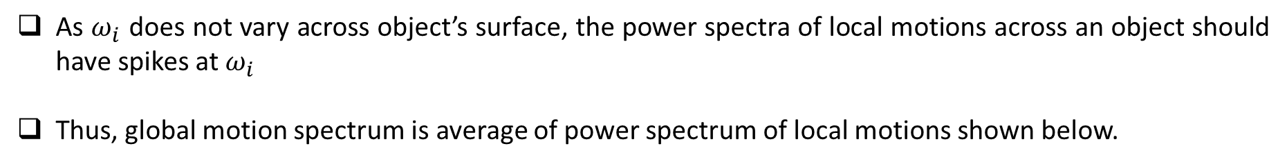
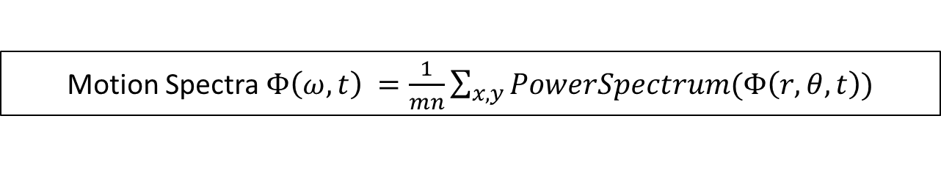
Motion Spectra
Intelligent Media Lab @ POSTECH
As $ω_{i}$ does not vary across object’s surface, the power spectra of local motions across an object should have spikes at $ω_{i}$
Thus, global motion spectrum is average of power spectrum of local motions shown below.
Motion Spectra $Φ\left(ω,t\right) =\frac{1}{mn}\sum_{x,y}{PowerSpectrum(Φ\left(r,θ,t\right))}$
Results in single temporal Motion Spectrum
Advantage of using temporal spectra as features – they offer invariance to changes in scale and viewpoint.

Slide 14
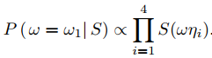
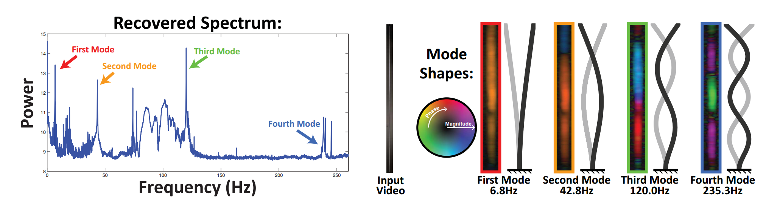
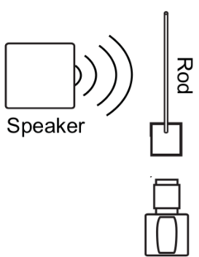

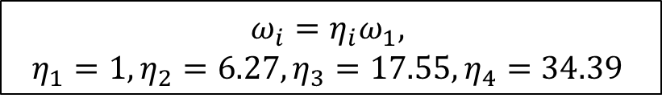
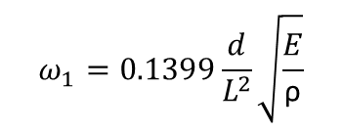
1. Estimating Material Properties for Known Geometry
Intelligent Media Lab @ POSTECH
Vibration modes for rigid bodies are a function of length (L), diameter (d), density (ρ ) and an elastic modulus (E).
Calculates elastic modulus which gives tensile strength of the rod from modal spikes in motion spectrum of rod.
A rod’s fundamental frequency is related to its material properties as
$$ω_{1}=0.1399\frac{d}{L^{2}}\sqrt{\frac{E}{\text{ρ}}}$$
$$ω_{i}=η_{i}ω_{1},$$
$$η_{1}=1, η_{2}=6.27,η_{3}=17.55,η_{4}=34.39$$
$i^{th}$ mode

Slide 15
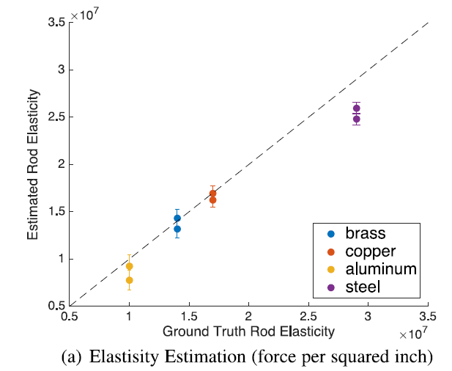
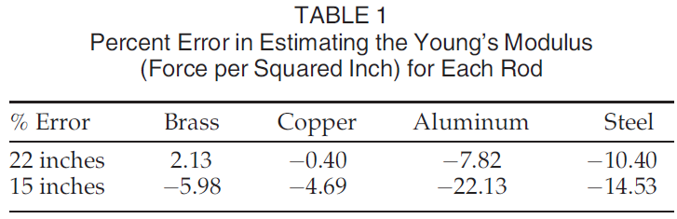
Results of Rod Property Estimation
Intelligent Media Lab @ POSTECH
Estimating Properties of Materials with Known Geometry: Rods.

Slide 16
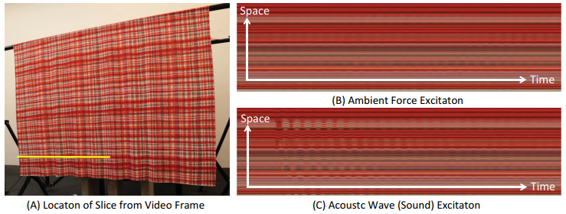
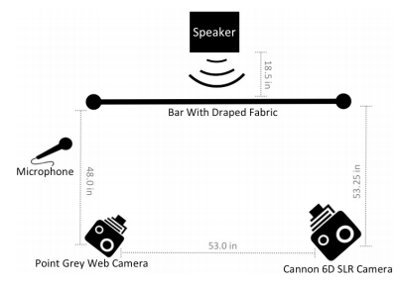
2. Estimating Material Properties for Unknown Geometry
Intelligent Media Lab @ POSTECH
Does not rely on knowing the ratios between resonant frequencies, which are difficult to compute in more general structures.
Learn relationships between motion spectra and the material properties of objects with regression models that map the motion spectra to the log of ground truth stiffness or area weight measurements.
Regression is performed in a lower dimensional space to avoid over-fitting (e.g. Principal Component Regression)
Setup
1)RGB SLR camera (Canon 6D, 1920×1080 px), 30 fps
2)Grayscale Point Grey camera (800×600 px), 60 fps

Slide 17
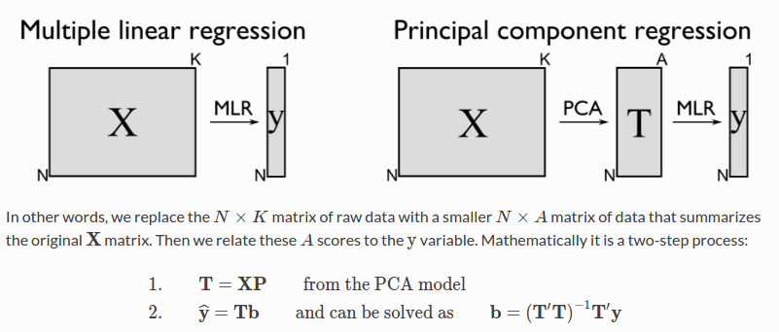
Regression Model
Intelligent Media Lab @ POSTECH
N = 150 uniform samples of the normalized motion spectra from 0 to 15 Hz are chosen as features.
Smooth the recovered motion spectra using a Gaussian with standard deviation 15/ 2(N−1)Hz.
Fitting a regression model directly to the processed motion spectra results in overfitting.
Principal Components Regression (PCR) and Partial Least Squares Regression (PLSR).
Both methods perform comparably, suggesting that the power of our algorithm is in the features.
A leave-one-out method for training and testing.
Least Square Method Solution

Slide 18


Results
Intelligent Media Lab @ POSTECH
Comparisons between ground truth and PCR model predictions on material properties estimated from videos of fabric excited by ambient forces and acoustic waves.
Each circle in the plots represents the estimated properties from a single video. Identical colors correspond to the same fabric.
The Pearson product-moment correlation coefficient (R-value) averaged across video samples containing the same fabric is displayed.
The features we use to estimate material properties are somewhat invariant to changes in excitation force and viewpoint

Slide 19



Frequency sensitivity and Modes of predictions
Intelligent Media Lab @ POSTECH
Regression model has no explicit notion of resonant frequencies; it simply looks for predictive patterns in the spectra of training data.
Analyzing the sensitivity of our recovered regression models we can see which frequencies are most predictive of material properties in our fabrics.
Sensitivity
Dimensionality reducing basis vectors
Estimated regression coefficients
The sensitivity of each acoustically trained model to frequency regions in the motion spectrum. These sensitivity plots suggest that energy in the 0-5 Hz range is most predictive of a fabric’s area weight and stiffness.
By visualizing recovered mode shapes at these frequencies, we see they contain the dominant vibration modes of our fabrics.
Models use the same relationship between resonant frequencies and material properties predicted by modal analysis

Slide 20
What we learnt
Intelligent Media Lab @ POSTECH
The rod experiments demonstrate how the technique can be used as a low cost alternative to laser vibrometers in settings that are typical for testing manufactured parts (aircraft, automobiles).
Results on fabrics demonstrate that the relationship between motion spectra and material properties can be learned, and suggests that traditional vibration analysis may be extended to applications where geometry is unknown and only loosely controlled.
Results suggest that the motion spectra we extract from video can be powerful features for scene understanding.

Slide 21
PART ONE Deep Convolutional Neural Network for Visual Microphone/ Visual Vibrometry
Credits: Juhyun Ahn, Postech- Visual Microphone
Deblina Bhattacharjee - Visual Vibrometry

Slide 22
Visual Microphone
Let:
$$A{\left(t\right)}_{x,y,ω,θ}$$
Amplitude
$${δ\left(t\right)}_{x,y,ω,θ}$$
Phase
Phase difference
(i.e. estimated displacement)
$$δ^{′}{\left(t\right)}_{x,y,ω,θ}={δ\left(1\right)}_{x,y,ω,θ}−{δ\left(t\right)}_{x,y,ω,θ}$$
For simplicity.. Consider only one scale and orientation.
Then:
$$s\left(t\right)=\sum_{x,y}{A^{2}{\left(t\right)}_{x,y}δ^{′}{\left(t\right)}_{x,y}}$$
$≡$ Convolution operation with weight $A^{2}{\left(t\right)}_{x,y}$

Slide 23

Patch-based Visual Microphone

Slide 24

Patch-based Visual Microphone
Similar to object classification?
Cat! (translation invariant)

Slide 25


Tanh Activiation

Slide 26


Convolutional Neural Network

Slide 27


History of Motion Magnification
detecting pulse from head motions
visual microphone
material property estimation from small motions
Year 2005
Year 2012
Year 2013
Year 2014
Year 2015
Motion Magnification
(Ce Liu et al.) [1]
Eulerian method
(Hao-Yu Wu et al.) [2]
Phase-based method
(Neal Wadhwa et al.) [3]
Riesz pyramid method
(Neal Wadhwa et al.) [4]
Magnification in presence of large motions
(Elgharib et al.) [5]
personally it’s the most important algorithm
Prof. William T. Freeman @ MIT CSAIL

Slide 28

Eulerian method
Motion Magnification [1]
Eulerian method [2]
Phase-based method [3]
Riesz pyramid method [4]
Magnification in presence of large motions [5]
problem: noise is amplified together with motion

Slide 29

DCNN based VM
Current video frame
* Video is resized to [80, 80]
Target video frame

Slide 30


Result
To be honest, not much difference.

Slide 31

Result
 | Intensity Difference | Original Visual Microphone | DCVM
(Chocobox, S4)
(Yogurt, S6)
(Chips, S1)
Don't ask me to carry an oily rag like that.
Don't ask me to carry an oily rag like that.
Don't ask me to carry an oily rag like that.
Don't ask me to carry an oily rag like that.
Don't ask me to carry an oily rag like that.
Don't ask me to carry an oily rag like that.
She had your dark suit in greasy wash water all year.
She had your dark suit in greasy wash water all year.
She had your dark suit in greasy wash water all year.
Surprisingly, simply adding up the intensity difference recovered the speech. It shows that the intensity difference contains speech information.

Slide 32
Problem
It fails to recover the sound after around 2,000 iterations.
Why?

Slide 33

Problem
Post-processing
Actual recovered speech using the Visual Microphone
(normalized to [0,1])

Slide 34
Problem
Sequence-1
{chips, choco-box, yogurt, foil, tissue}
Sequence-2
{chips, choco-box, yogurt, foil, tissue}
Sequence-3
{chips, choco-box, yogurt, foil, tissue}
Not enough sequences
to train
deep neural network!!!
Sequence-4
{chips, choco-box, yogurt, foil, tissue}
Sequence-5
{chips, choco-box, yogurt, foil, tissue}
Sequence-6
{chips, choco-box, yogurt, foil, tissue}

Slide 35
PART TWO Improving Quality of Visual Microphone using Unsupervised Deep Bi-directional LSTM Network.

Slide 36

Why recovered speech doesn’t sound good?
- Sampling rate:
960
- Therefore by the Nyquist sampling theorem:
Maximum frequency in the recovered speech is 430Hz.
- 0~200Hz are band-pass filtered for speech signals.
Recovered speech contains only 200~430Hz speech signals.
Sony RX10-3:
960fps.

Slide 37


Why recovered speech doesn’t sound good?
Band-pass filtered [0Hz, 430Hz] & resampled (960fps)

Slide 38
Why recovered speech doesn’t sound good?
?
Training can be done using normal speech sequences
– i.e. unsupervised learning!!

Slide 39
Why recovered speech doesn’t sound good?
Actually, it is called audio bandwidth extension in signal processing community.
However, surprisingly no one has tried to solve this problem using Bi-directional LSTM network.

Slide 40
Deep Bi-directional LSTM network
257
Fully-connected layer
1024
512
Bi-directional LSTM layer
512
512
256
Bi-directional LSTM layer
256
1024
512
Bi-directional LSTM layer
512
257

Slide 41
TIMIT dataset
630 speakers * 10 speech files = 6,300.
Training data:
(630-3) * 10 speech files = 6,270 files.

Slide 42






Result - English
Original Speech
Visual Microphone
Bandwidth Extended (1,000Hz)
She had your dark suit in greasy wash water all year.
She had your dark suit in greasy wash water all year.
She had your dark suit in greasy wash water all year.
Don't ask me to carry an oily rag like that.
Don't ask me to carry an oily rag like that.
Don't ask me to carry an oily rag like that.

Slide 43









Result - Korean
Original Speech
Visual Microphone
Bandwidth Extended (1,000Hz)
아시아나 항공을 이용해주신 승객 여러분께
아시아나 항공을 이용해주신 승객 여러분께
아시아나 항공을 이용해주신 승객 여러분께
안전을 위해 좌석 벨트는 계속 매고 계시고
안전을 위해 좌석 벨트는 계속 매고 계시고
안전을 위해 좌석 벨트는 계속 매고 계시고
안에있는 물건이 떨어져 다치지 않도록
안에있는 물건이 떨어져 다치지 않도록
안에있는 물건이 떨어져 다치지 않도록

Slide 44


Most recent work in Audio Bandwidth Extension
https://github.com/kuleshov/audio-super-res
(*NO SOURCE CODE, only demo audio files.)

Slide 45


Appendix- Review on RNN

Slide 46


Review on RNN

Slide 47

Review on RNN

Slide 48

Review on RNN

Slide 49

Review on RNN

Slide 50

Review on RNN

Slide 51

Review on RNN

